Slide 1
ABE651 Lab 11 Presentation Graphics
Joshua Tellier 4/17/2020

Slide 2
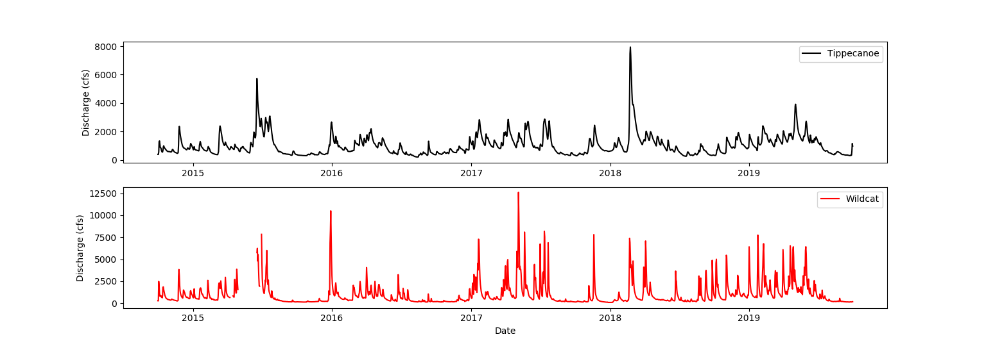
Figure 1: Daily streamflow values for the past 5 years of record for two Indiana rivers. Data collected by USGS streamflow gauging stations near Lafayette, IN. Tippecanoe River values in black, Wildcat Creek values in red. Note the small period on the Wildcat data in mid-2015 in which no data was recorded.

Slide 3
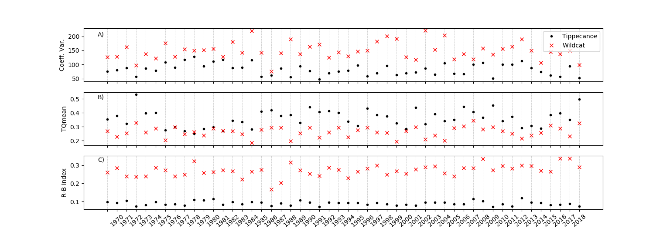
Figure 2: Mean annual statistics for three measures of streamflow discharge for two rivers in west-central Indiana over a 50-year period. A) Coefficient of variation of daily discharge values. B) Fraction of time that a streamflow values exceeds the mean streamflow for a year. C) R-B flashiness index. Tippecanoe river values shown as black dots. Wildcat Creek values shown as red crosses.

Slide 4
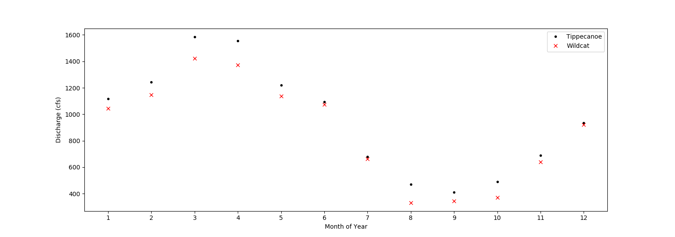
Figure 3: Mean monthly flow averaged over a 50-year timespan for two rivers in west-central Indiana. X-axis is month of calendar year (January = 1). Tippecanoe river values displayed as black dots. Wildcat Creek values displayed as red crosses.

Slide 5
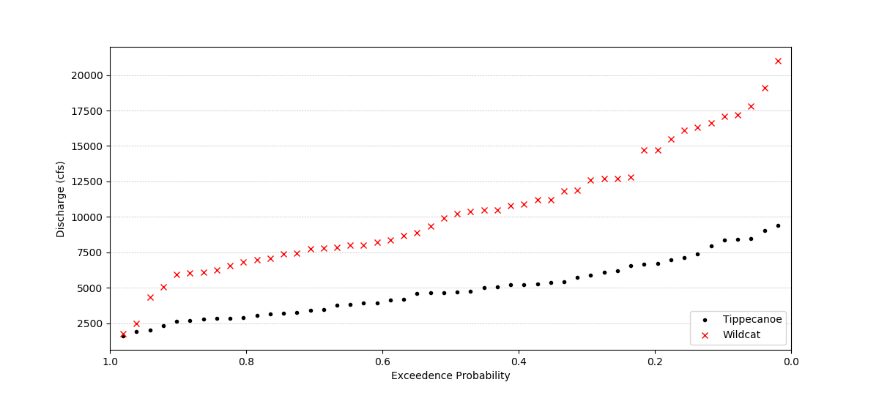
Figure 4: Calculated exceedance probabilities for given discharge rates for two rives in west-central Indiana. Tippecanoe River values displayed as black dots. Wildcat Creek values displayed as red crosses. Note that probability is equal to one at the origin, and decreases in probability along the x-axis.

